Slide 1

Unsupervised & Supervised Learning

Slide 2
Outline
Machine Learning
Unsupervised Learning
Supervised Learning

Slide 3
Machine Learning
The study of computer algorithms that improve automatically through experience.
TRAINING
VALIDATING
TESTING

Slide 4
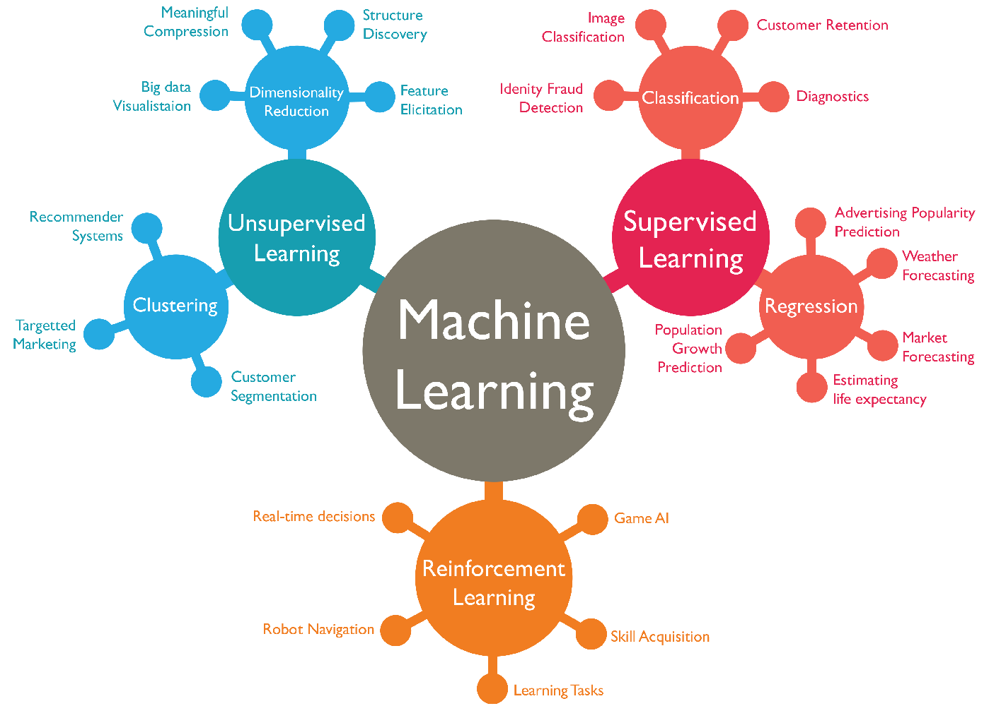
Source : https://www.wordstream.com/blog/ws/2017/07/28/machine-learning-applications

Slide 5
Supervised Learning
the training of machine using information that is classified/labeled.
Classification
Regression

Slide 6
Unsupervised Learning
the training of machine using information that is not classified (no labeled) and without guidance.
Dimensional Reduction (Principal Component Analysis)
Clustering

Slide 7
Clustering
the process of organizing objects into groups whose members are similar in some way.
K-Means Clustering (define K centroids/cluster)
Fuzzy C-Means Clustering (data point can be assigned into more than one cluster)
Hierarchical Clustering

